Slide 1



Mentorness
YOUTUBE SONG
ANALYSIS
Okeke Princess

Slide 2

OVERVIEW
01
02
03
04
05
Problem statement
Dataset Cleaning
in PowerBI
Analysis in Power BI
Findings
Recommendations

Slide 3
PROBLEM
STATEMENT
This project aims to conduct a comprehensive analysis of YouTube songs data using Power BI.
The goal is to utilize Power BI to create insightful visualizations and reports that provide a deeper understanding of YouTube songs’ performance, popularity, and user engagement.

Slide 4

DATASET CLEANING
03
01
Data Exploration &
Analysis Process
Insert Dataset
02
Clean Dataset
Check for Null, Duplicate, Irrelevant Values or Columns

Slide 5
ANALYSIS IN POWER BI
Exploratory Data Analysis
Explore patterns in view counts, like counts, and comments
Content and Channel Analysis
Identify popular tags and thier correlation with view counts
Temporal Trends
Identify peak publishing times and their impact on engagement
User Engagement Insights
Identify factors influencing user engagement with YouTube song videos

Slide 6
FINDINGS
Power BI Dashboard
Power BI Reports
Interactive Dashboards showcasing visualizations of YouTube song data trends.
Reports detailing channel and content analysis, temporal trends, and user engagement insights.

Slide 7

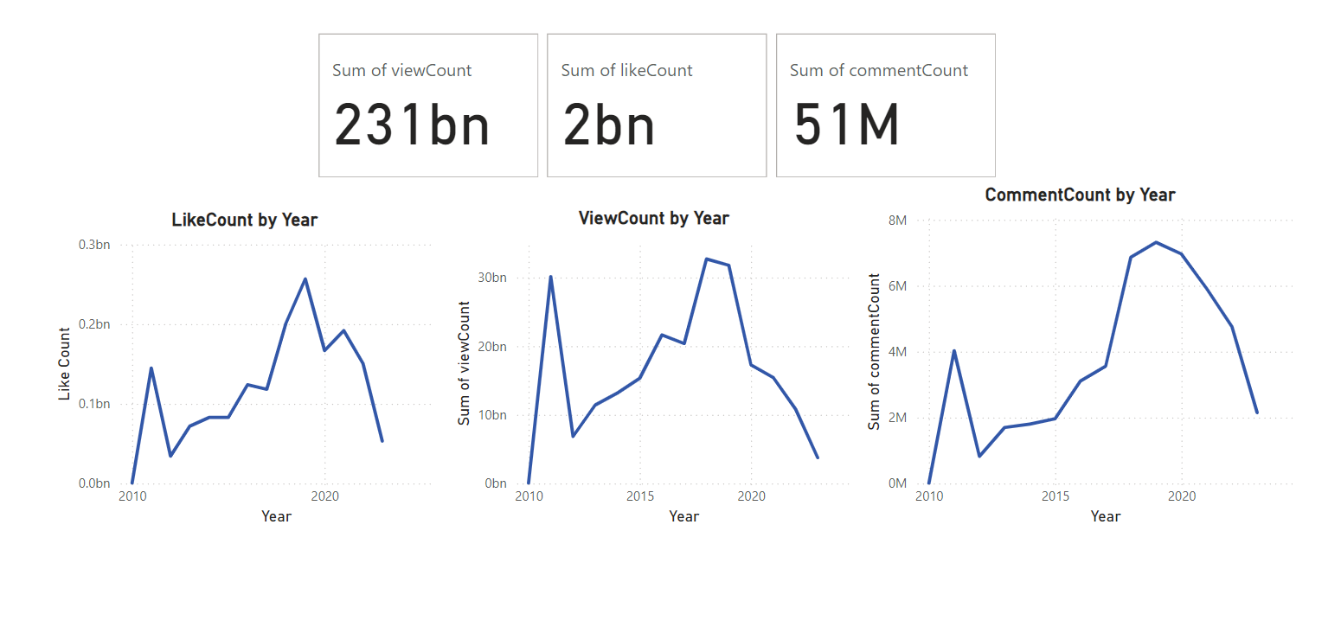
Exploratory Data Analysis

Slide 8
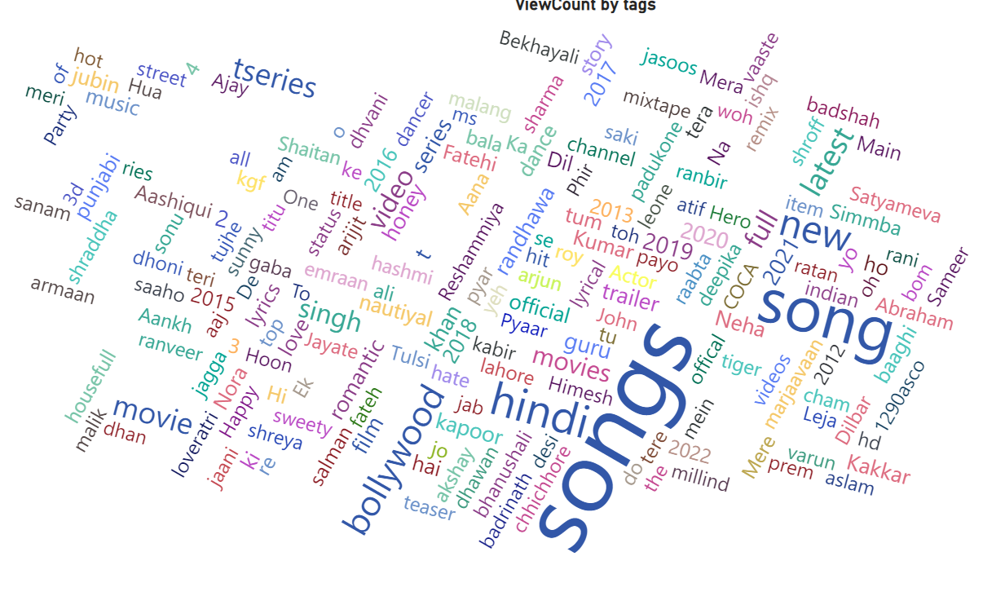
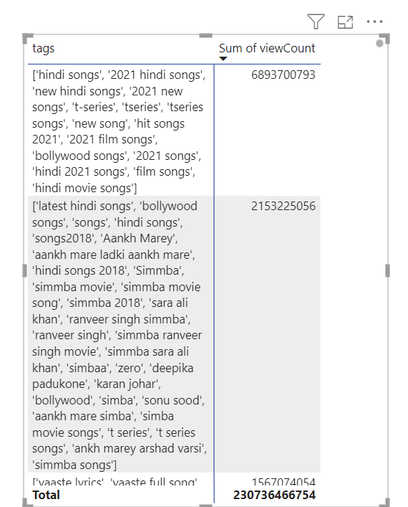
Content and Channel Analysis

Slide 9
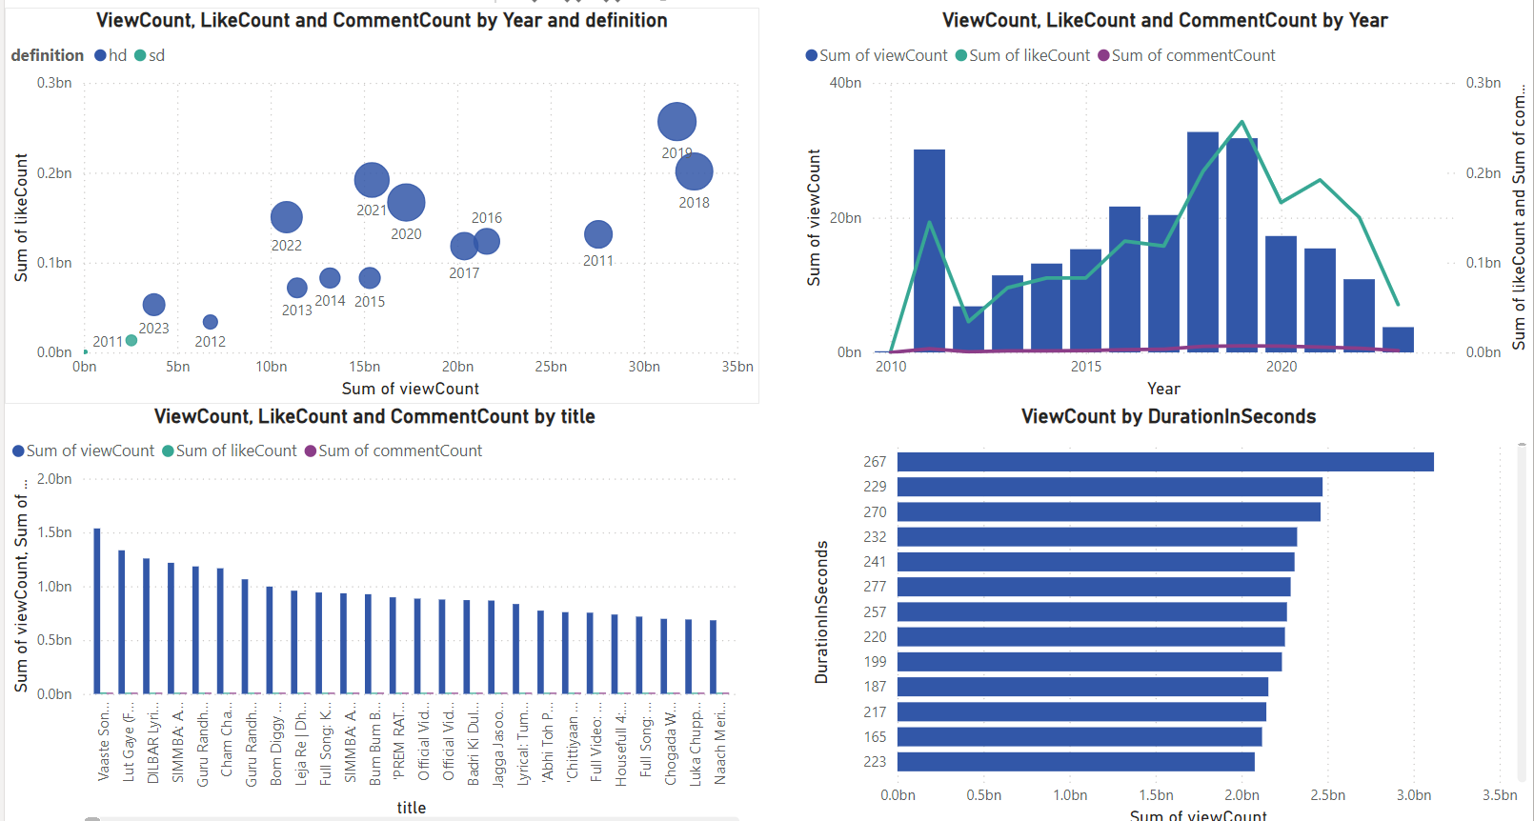
Temporal Trends

Slide 10
User Engagement Insights
Factors Influencing user engagement with YouTube song videos
01
02
03
Duration
Tags
Definition

Slide 11
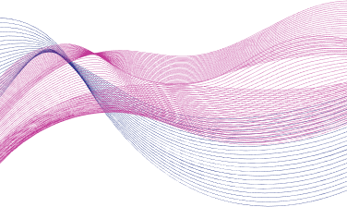
RECOMMENDATIONS
Target Duration
Aim to produce videos that are between 200 and 300 seconds long. This duration has shown the highest engagement rates, suggesting that viewers prefer content within this time frame.
Effective Tags
Ensure that the tags "songs" and "song" are included in the metadata of all relevant videos. These tags have been associated with higher engagement, making them crucial for attracting and retaining viewers.
High Definition
Prioritize uploading videos in HD quality. Videos with HD definition have demonstrated higher engagement, indicating that viewers value and prefer high-quality visuals.

